Slide 1
影像處理、電腦視覺及深度學習概論 (Introduction to Image Processing, Computer Vision and Deep Learning) Homework 2
TA:
Kevin: i1007673219@gmail.com
Office Hour: 19:00~21:00, Mon.
09:00~11:00, Wed.
At CSIE 9F Robotics Lab.

Slide 2
Notice (1/2)
Copy homework is strictly prohibited!! Penalty: Grade will be zero for both persons!!
If the code can’t run, you can come to our Lab within one week and show that your programming can work. Otherwise you will get zero!!
Due date => 2020/01/02 (Thu.) 23:59:59
No delay. If you submit homework after deadline, you will get 0.
Upload to => 140.116.154.1 -> Upload/Homework/OpenCvdl_Hw2
User ID: opencvdl2019 Password: opencvdl2019
Format
Filename: Hw2_StudentID_Name_Version.rar
Ex: Hw2_F71234567_林小明_v1.rar
If you want to update your file, you should update your version to be v2, ex: Hw2_F71234567_林小明_v2.rar
Content: project folder*( including the pictures ) *note: remove your “Debug” folder to reduce file size

Slide 3
Notice (2/2)
C++ (check MFC guide in ftp)
OpenCV 3.3.1 (https://opencv.org/release.html)
Visual Studio 2015 (download from http://www.cc.ncku.edu.tw/download/)
UI framework: MFC
Python
Python 3.7 (https://www.python.org/downloads/)
Tensorflow 2.0 / PyTorch 1.3.0
opencv-contrib-python (3.4.2.17)
Matplotlib 3.1.1
UI framework: pyqt5 (5.11.3)

Slide 4
Assignment scoring (Total: 100%)
0. GUI
1. Stereo (30%) (出題：Kris)
2. Background Subtraction (20%) (出題：Yi Yuan)
3. Optical Flow (30%) (出題：Shaku)
3.1 Preprocessing (10%)
3.2 Video tracking (20%)
4. AR (20%) (出題: Rex)

Slide 5
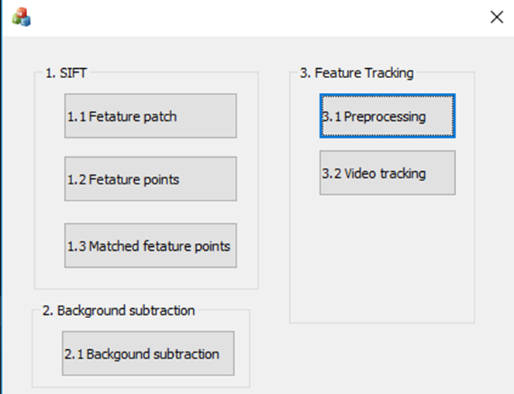
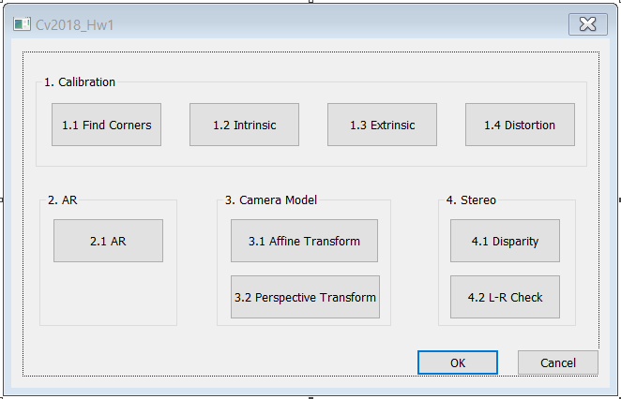
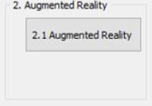
0. GUI
Use MFC to create GUI like following figure.

Slide 6
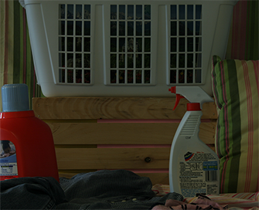
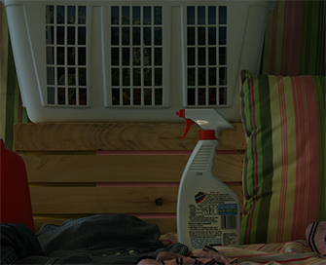
1. (30%) Stereo Disparity Map (出題：Kris)
Given: a pair of images, imL.png and imR.png (have been rectified)
Q: 1) Find the disparity map/image based on Left and Right stereo images.
2) Compare the result of the disparity map with and without the left-right disparity check, and mark the difference between the above result in red.
imL.png
imR.png
Left Image (Reference Image)
Right Image

Slide 7
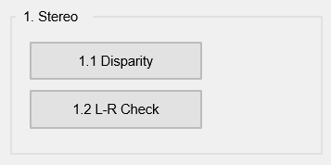
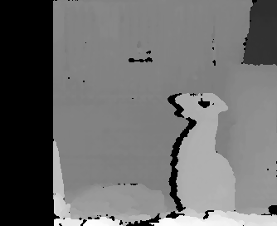
1.1 (30%) Disparity Map
Q: 1) Click button “1.1” to show the disparity map
Guides:
(1) Window Size: 9 = 3*3 pixel
(2) Search range and direction:
Disparity range: 0~64 pixels.
Map disparity range 0~64 pixels to gray value range 0~255 for the purpose of visualization.
If the left image is the reference image (the one used to cal. depth info for each pixel of that img), then the search direction at right image will go from the right to left direction.
Hint: OpenCV Textbook Chapter 12 (P.451)
StereoBM::create(64, 9);
Result

Slide 8
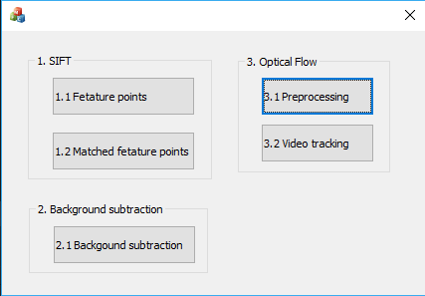
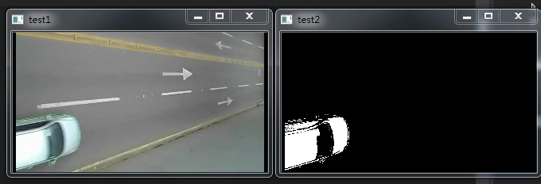
2. (20%) Background Subtraction (出題：Yi Yuan)
Given a video: bgSub.mp4
Q: 1) Click the button “2.1 Background Subtraction” to open two windows:
One shows the original video, bgSub.mp4
The other is the foreground video.
Use first 50 frames to train the background model
You need to subtract background model to find the foreground object (white part)
Hint : textbook p372 ~ p376
Demo video:

Slide 9
3. (30%) Optical Flow (出題：Shaku)
3.1 Preprocessing (10%)
3.2 Video tracking (20%)

Slide 10
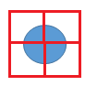
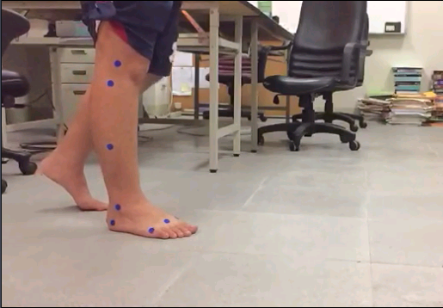
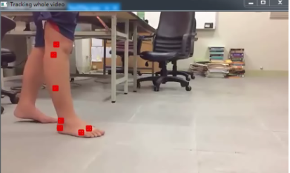
3.1 Preprocessing (10%) (出題：Shaku)
Given a video: opticalFlow.mp4
Q: 1) Click the button “3.1 Preprocessing” to:
Manually (setMouseCallback ) or automatically (SimpleBlobDetector) detect 7 center points of 7 blue circles of the 1st frame.
Show the square boundary (not red filled like the ex. image).
window size: 11
7 blue circles
Center point
Ex:
(0,0)
x
y

Slide 11
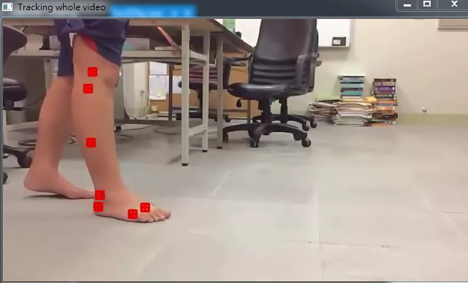
3.2 Video tracking (20%) (出題：Shaku)
Q: 2) Click button “3.2 Video tracking” to
(10%) Track the 7 center points on the whole video using OpenCv function calcOpticalFlowPyrLK(args, winsize=21x21). Ex: https://github.com/opencv/opencv/blob/master/samples/cpp/lkdemo.cpp
(10%) Connect 7 corresponding tracking points of all frames (the whole video) to get 7 trajectories (flow). Ex: the demo video.
Hint: textbook Chapter 10 (p332 ~ p334)
Demo video:
※ Tracking process may be fail, you should make the result as good as possible (at least 4~5 points success)

Slide 12
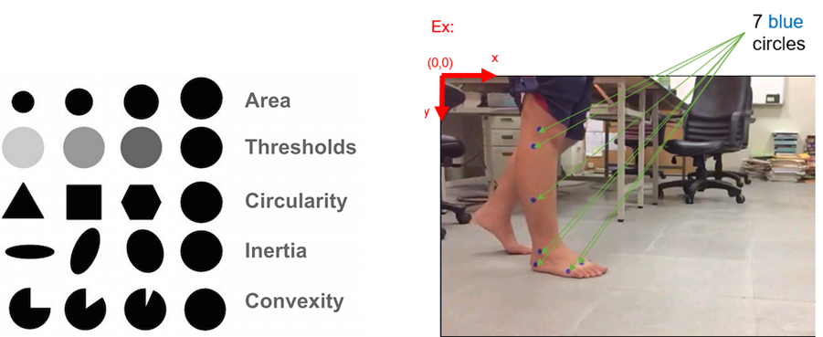
How to detect 7 center points of 7 blue circles
You can:
1. Using mouse callback function (Please explain how to manipulate your GUI)
2. Using SimpleBlobDetector to detect blobs (binary large object), it can filter out blobs by examining their:
Area (size)
Thresholds (gray level)
Circularity (if perfect circle, then it is 1.0)
Inertia (ratio of the minor and major axes )
Convexity (if no gap, then it is 1.0)

Slide 13
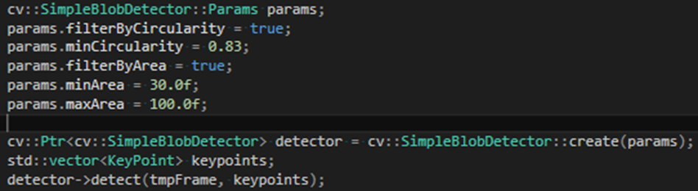
SimpleBlobDetector Usage (C++ Example)
Setup parameters (only circularity and area examination is used)
Create SimpleBlobDetector with parameters
Detect by use detector->detect(input_images,output_keypoints)

Slide 14
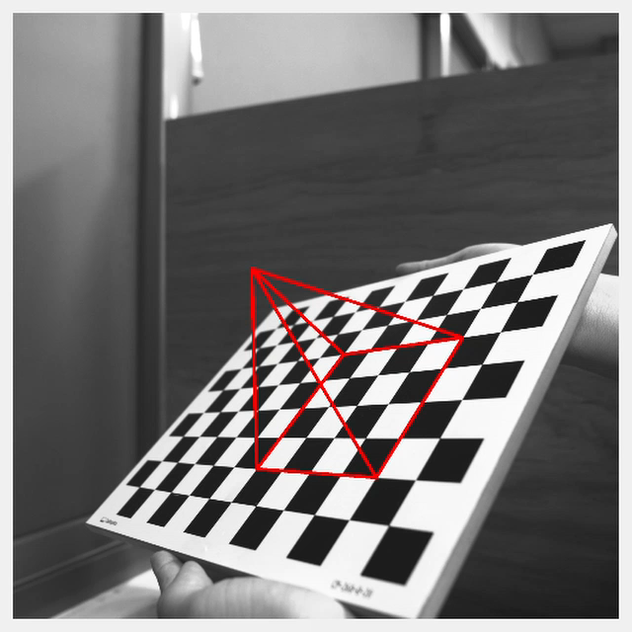
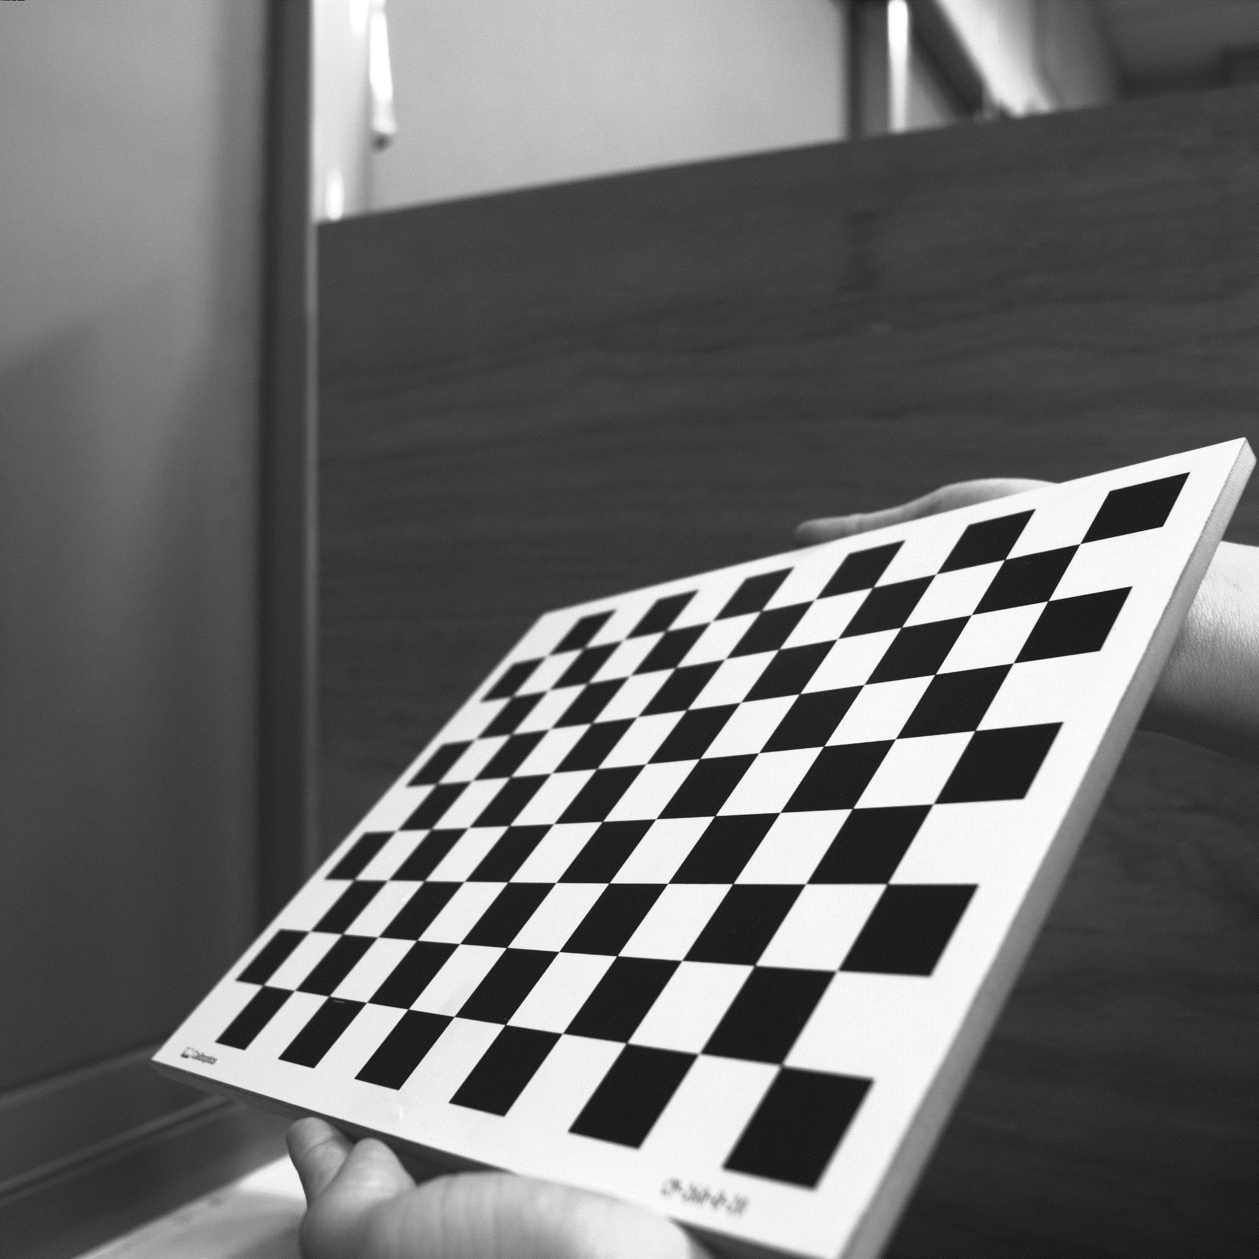
4. (20%) Augmented Reality (出題：Rex)
Given: intrinsic and extrinsic parameters, distortion coefficients, 5 images: 1~5.bmp
Q: 1) Draw a “pyramid” on the chessboards images(1.bmp to 5.bmp) then
2) Click the button ”2” to show the pyramid on the picture. Show each picture 0.5 seconds (total 5 images)
Hint : Textbook Chapter 11, p.387~395 Calibration
p.405~412 Projection
cv::projectPoints()
Demo video:
3D Object coordinates:
Vertex (3, 3, -4)
Corners(1, 1, 0)(1, 5, 0)(5, 5, 0)(5, 1, 0)
(3,3,0)
(3, 3, -4)
(5, 5, 0)
(1, 5, 0)
(5, 1, 0)
(1, 1, 0)

Slide 15
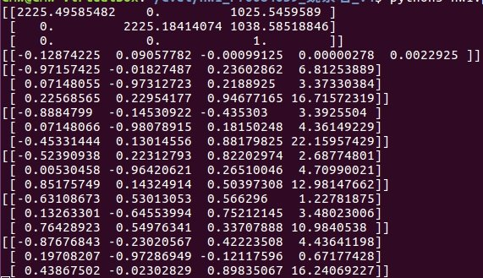
4. Augmented Reality (出題：Rex)
Intrinsic
distortion
1.bmp extrinsic
2.bmp extrinsic
3.bmp extrinsic
4.bmp extrinsic
5.bmp extrinsic

